Slide 1

Loan Defaulter Data Analysis Priya Arvind & Ivan Saravanja

Slide 2

Introduction
Our project focused on loan defaulters and our report covers the different stages of the project, including data understanding, data preparation, data visualisation and machine learning implementation.
The goal of the project was to help a finance company to identify which loan applicants are likely to repay their loans and which ones are likely to default.
Our plan is to apply our skills from data preparation and machine learning to a real-world problem, while also demonstrating our ability to work together and manage a project effectively.
Notes:
In our first continuous assessment, our group had to work collaboratively to apply project management methodology on project through which we develop and execute all the acquired skills gained from classes. We were supposed to find the appropriate dataset, conduct explanatory data analysis, pre-process the data, implement at least one machine learning algorithm and present our findings and conclusions.
Our project focused on loan defaulters and our report covers the different stages of the project, including data understanding, data preparation, data visualisation and machine learning implementation. The goal of the project was to help a finance company to identify which loan applicants are likely to repay their loans and which ones are likely to default. By understanding the factors that lead to loan default, the company can make better decision about to who to lend money to. Overall, this project allowed us to apply our skills from data preparation and machine learning to a real-world problem, while also demonstrating our ability to work together and manage a project effectively.

Slide 3

Business Understanding
Clients have trouble deciding which applicants are likely to repay their loans
When they receive loan applications, they face two risks: not approving loan for someone who is likely to repay it, or approving a loan for someone who is likely to default it
By identifying patterns in data, we aim to help the company better assess the risk of loan default and make more informed decisions about loan approvals.
Notes:
Business Understanding
This is the case study where we will use EDA to help client finance company that specialises in lending loans to their customers. They are having trouble deciding which applicants are likely to repay their loans, since some people with insufficient or non-existent credit histories take advantage of the system by becoming defaulters. When they receive loan applications, they face two risks: not approving loan for someone who is likely to repay it, or approving a loan for someone who is likely to default it, both of which are resulting in financial loss for the company. To deal with this problem, we will be analysing a dataset that contains information about loan applications, including those from clients with payment difficulties and those who have paid loans on time. When someone applies for loan, there are four possible outcomes: the loan can be approved, cancelled by the client, refused by the company or left unused. In our study, all outcomes besides “Approved” will be marked as unsuccessful. By identifying patterns in data, we aim to help the company better assess the risk of loan default and make more informed decisions about loan approvals.

Slide 4
Technologies used
Libraries
During the assignment execution, we were using multiple libraries:
Pandas
sklearn.decomposition
Numpy
Seaborn
Matplotlib etc.
Machine Learning Models
Decision Tree
Logistic Regression
Random Forrest
Random Forrest Classifier
KNN Classification

Slide 5
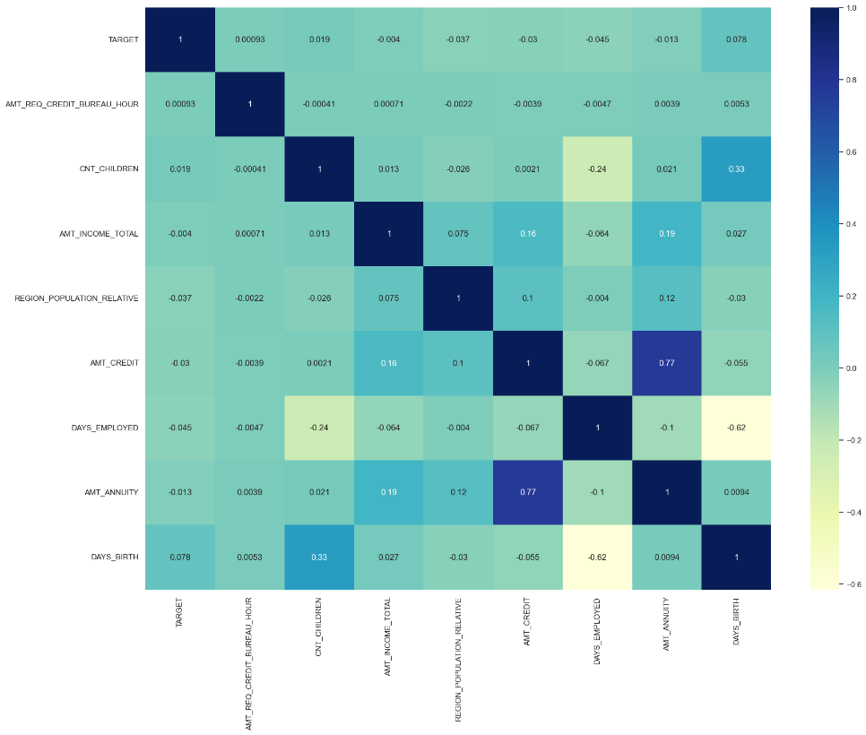
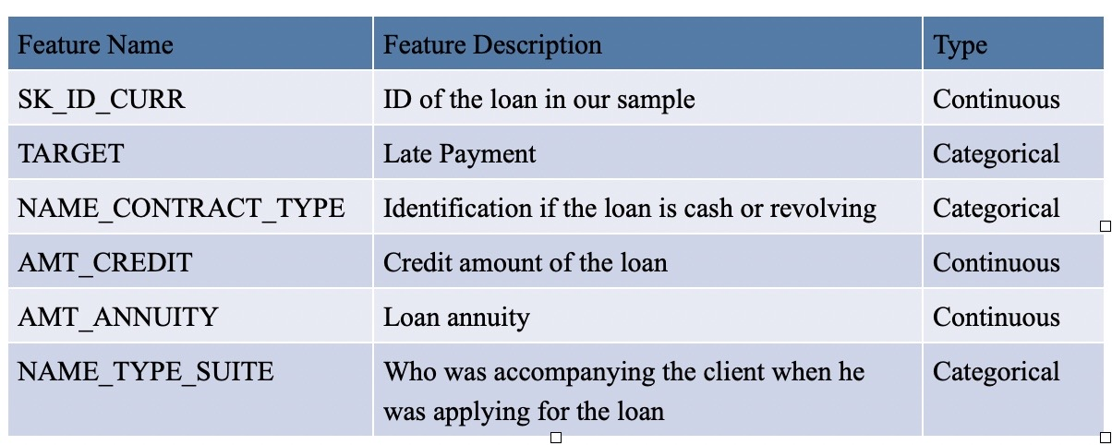
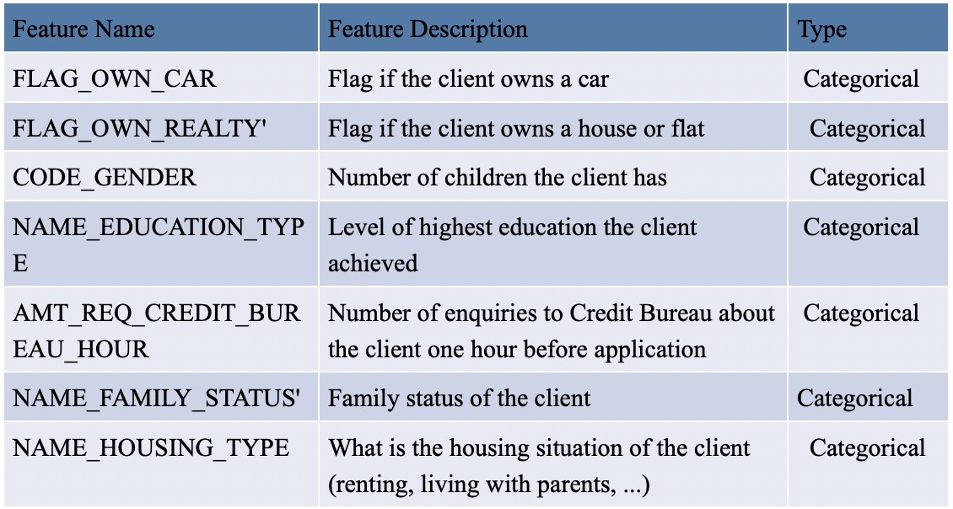
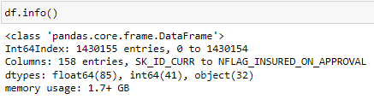
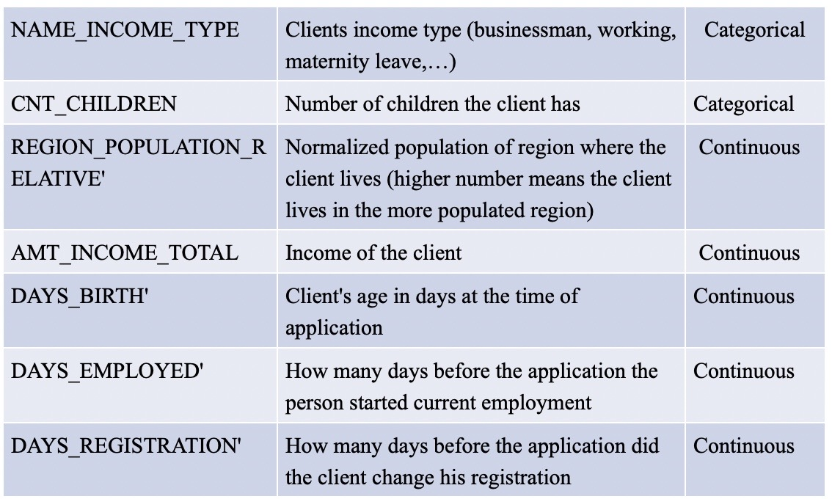
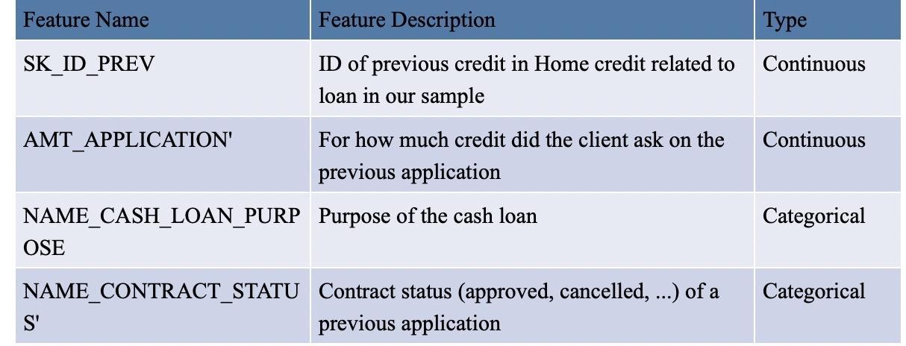
Data Understanding
Total 2 datasets namely ‘application_data.csv’ and ‘previous_application.csv’ taken from:
https://www.kaggle.com/datasets/gauravduttakiit/loan-defaulter
Dataset dimensions: Dataset1 (307511, 122), Dataset2 (1670214, 37)
Total Dataset dimensions: 1430155 rows and 158 columns
Notes:
Our dataset was fairly a large dataset, consisting of two datasets merged into one: “application_dataset.csv” and “previous_application.csv”. Initially, our dataset consisted of 1430154 rows and 158 columns. Out of those 158 columns, 85 of them were float64 type, 41 int64 and 32 object columns.

Slide 6
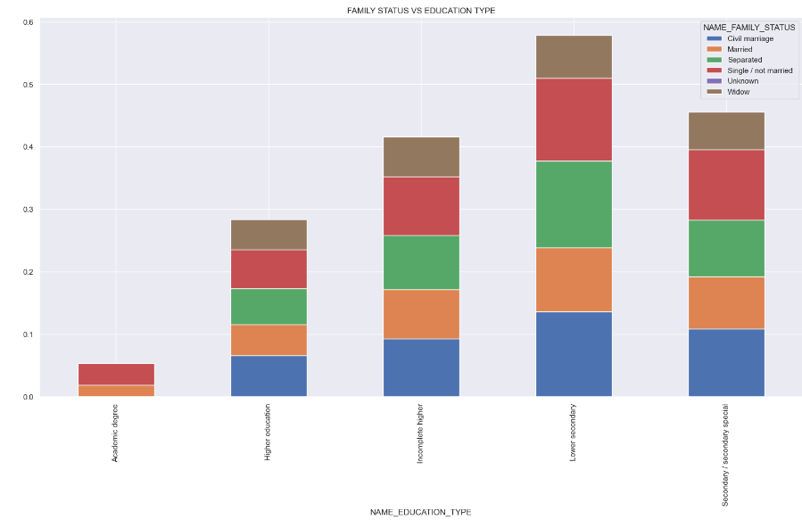
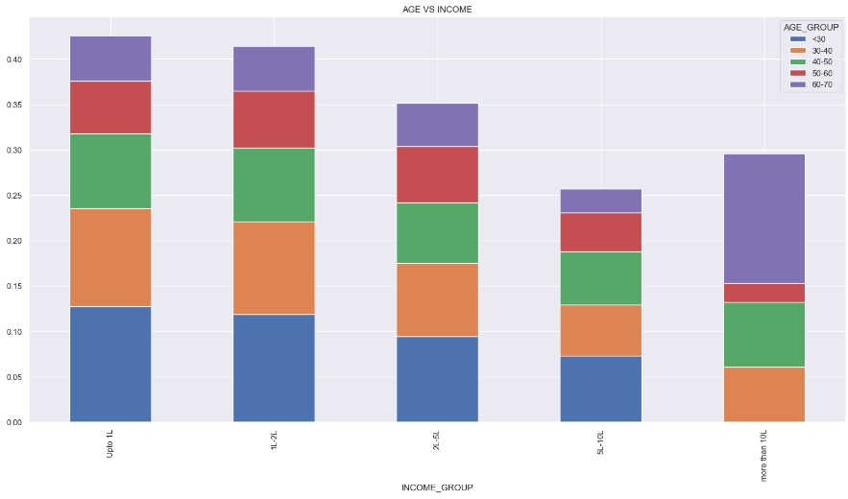
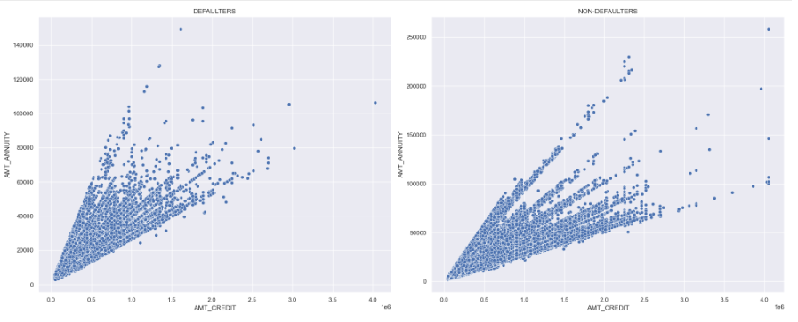
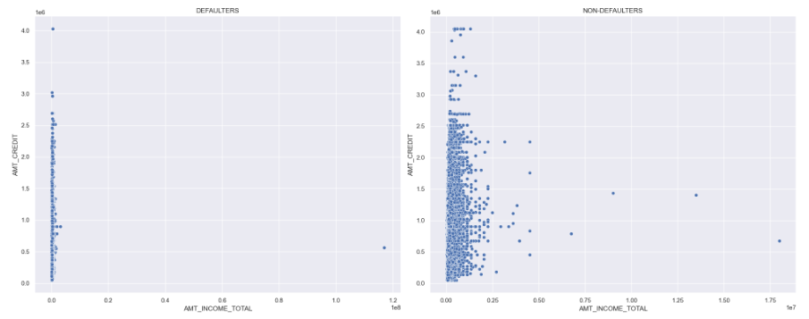
* Females are the majority availed of loans when compared with men.
* The secondary education category is the highest availed of loan. The 30-40 age group are the highest number of availed loans and the 60-70 age group is the lowest.
* Both target variables are imbalanced, with fewer defaulters in the Target feature and fewer unsuccessful Contract statuses.
* Payment defaulters are the majority low-income group of people.
Also, a higher credit amount is given to low-income people than higher income people.
* we could see positive correlation between credit and annuity with respect to Target variable.
* Payment Defaulters have been employed for an average of less than 3 years and having one outliner with a value 1000 years Repayers are employed for an average of 5+ years.
*Age group of <30 earning less than 1Lakh are most likely to have payment difficulties. Income group 5L-10L shows the least chances of payment difficulty. Income group 'more than 10L' are outliers, thus considering them as isolated events.

Slide 7

Data Preparation
Data Preparation Methods used:
Feature selection
Removing NaN values
Removing duplicates
Converting negative to absolute values
Replacing categorical variables with numerical values
Notes:
Before removing the NaN values, we plotted a bar chart to visualise the percentage of missing values in each attribute of our data frame. Also, we provided a heatmap as well to show distribution of the missing values. We got the result that 7 attributes only have missing values and the one that has the most is “AMT_REQ_CREDIT_BUREAU_HOUR”. After finding out which features contain missing values and in which percentage, we proceed to removing the missing values. Since our dataset contained more than million rows, there was no issues with dropping certain amount of rows and reducing the size of the dataset.
After removing the missing values, our next step was to remove the duplicates. Due to merging two datasets into one based on mutual, SK_ID_CURR column, new dataset contained many duplicates. What we did first was to check how many rows have duplicated ID.
During the data cleaning, we realised we have some columns in negative values which were showing how many days passed since some certain event (birth, employment day, registration day etc.). As those values mean the same thing if shown in positive values, we decided to convert them from negative to absolute values.
Next important step in data preparation was to replace all the categorical variables with numerical values, to be able to run our machine learning models.
First thing we did was to check how many object columns we have in our dataset and which ones are them. Next step was to get all unique values for each object column, to be able to replace them with numerical value. Last step in this process was to replace all unique categorical variables with numeric values. We used dictionary mapping that replaced specific unique values in the data frame with corresponding numeric values. By doing this, our dataset was filled with numerical values only and was ready for machine learning models

Slide 8
Model Building
After considering characteristics of the problem we are trying to solve, the data we have and after executing the EDA, we decided to go with supervised machine learning classification models:
Decision Tree
Logistic Regression
Random Forrest
Random Forrest Classification
KNN Classification

Slide 9
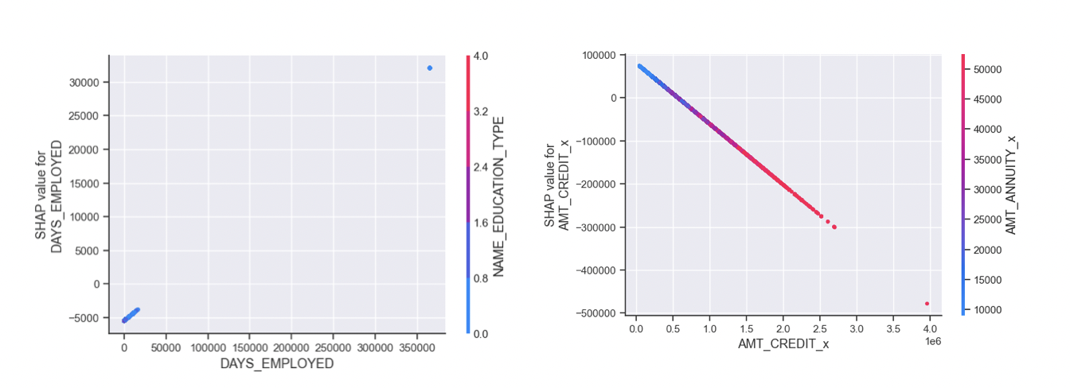
Model Explainability
We used SHAP to get a general Explanation, with the aim of understanding and using the SHAP package for this classification problem in order to understand what are the factors which influence a target variable, the Defaulter. Which features of a Loan Application affect the target variable and whether they impact it positively or negatively?
The predicted Defaulters are driven down mainly because of these 7 reasons: AMT_APPLICATION -For how much credit did the client ask on the previous application AMT_CREDIT is the Final credit amount on the previous application. This differs from AMT_APPLICATION in a way that the AMT_APPLICATION is the amount for which the client initially applied, but during our approval process he could have received a different amount - AMT_CREDIT Days of Employed Total income Age Annuity of the previous application

Slide 10
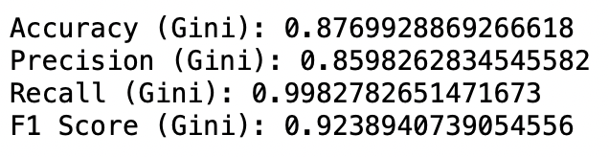
Evaluation
Contract Status Prediction Decision Tree model for this problem as we were dealing with categorical variables which didn't need much preprocessing and this model is really good at handling those. Also, it can provide feature importance, which helps us to identify which features are most influential in making predictions with 87% accuracy is able to achieve.
Similarly, for the Target -Defaulter variable, the Random Forest and GradientBoostingClassifier fitted very well. Gradient Boosting is a type of machine learning boosting technique and the main idea of gradient boosting is to attain a model that eliminates the errors of the previous models

Slide 11

Challenges
Our main challenge was the size of the dataset. Due to its size and the fact it consisted by 2 separated datasets, we had to create one, merged dataset.

Slide 12
Conclusion
This assignment provided valuable insights into loan default and success application status
In conclusion, this assignment provided valuable insights into loan default and success application status. It highlighted the importance of analysing important variables, identifying patterns, and refining the predictive model to make more accurate predictions. By addressing these aspects, we can enhance decision-making processes, minimize default risks, and improve loan contract outcomes.
Lower secondary education Marriage and single people are the riskiest categories exhibiting payment difficulty. Widows have shown less percentage of payment difficulty through all Education types. Academic degree Education type shows fewer chances of a payment difficulty.
Suggestion: Having more information about the reason for the cancellation or refusal of previous loans could lead to more repaying applicants in the future.
Notes:
Conclusion
Through exploratory data analysis, feature engineering, dimensionality reduction, and feature selection techniques, we gained insights into the dataset we have chosen before.
We trained and evaluated various machine learning models, including Decision Tree, Logistic Regression, Random Forest, and K-Nearest Neighbors (KNN) in order to see which one would give us the best predictions.
The results showed that the KNN model performed the best with an accuracy score of 92%, indicating its ability to effectively predict defaulters and contract status. However, further analysis is required to understand the underlying patterns and variables that contribute to loan default and success application status.
To improve the models, it is recommended to conduct more in-depth analysis of the important variables behind loan default, identify patterns indicating clients' difficulty in paying installments, and refine the predictive model. This may involve exploring additional variables, conducting statistical tests, and utilizing more advanced machine learning techniques.
By refining and building a better model, we can enhance our ability to predict defaulters and contract status accurately. This will enable us to make informed decisions in loan application evaluations, mitigate risks associated with loan default, and improve the overall success rate of loan contracts.
In conclusion, this assignment provided valuable insights into loan default and success application status. It highlighted the importance of analysing important variables, identifying patterns, and refining the predictive model to make more accurate predictions. By addressing these aspects, we can enhance decision-making processes, minimize default risks, and improve loan contract outcomes.

